Slide 1
Session 2 An overview of financial accounting

Slide 2
What is accounting?
What is accounting?
Process of identifying, measuring, and communicating economic events in value terms, to provide information for economic decision-making.
What is financial accounting?
What is managerial accounting?

Slide 3
Financial Accounting System
Economic events
cc
omic Events
GAAP – Generally Accepted Accounting Principles (promulgated by Financial Accounting Standards Board (FASB))
IFRS – International Financial Reporting Standards
Accounting Rules
&
Management Estimates
The application of accounting rules often requires the use of managerial estimates
Financial Statements
Independent external auditors check the information reported to ensure that it is accurate and consistent with the reporting standards
Used by parties external to the firm: investors, creditors, employees, customers, suppliers, competitors, and regulators

Slide 4
What’s in financial accounting?
Four financial statements
- Balance Sheet (BS) – levels statement
- Income Statement (IS) – Flow statement
- Statement of Cash Flows (SCF) – Flow statement
- Statement of Owner’s Equity (SOE) – Flow statement
Footnotes (full disclosure)
MD&A (Management Discussion and Analysis)
Annual report (10-K), Quarterly report (10-Q).
Proxy statement - directors and executive compensation (DEF 14A)

Slide 5
The balance sheet – Levels
Describes the firm’s resources and claims. (This is a statement of levels at a single point in time.)
Assets: Economic resources of the company that are expected to generate future cash inflows
Liabilities: Economic obligations due to other entities that are expected to generate future cash outflows
Equity Residual (Assets – Liabilities)

Slide 6
More formal definition
Assets:
(1) The firm controls it.
(2) Its acquisition (ownership) is based on a past transaction or event.
(3) It has a probable future economic benefit.
Liabilities:
(1) The firm cannot avoid it.
(2) Its incurrence (“ownership”) is based on a past transaction or event.
(3) It has a probable future economic sacrifice.
Equity is the residual

Slide 7
Starbucks

Slide 9
The income statement - Flows
The income statement is report of the operating performance of a firm during a period of time.
Revenue: Inflow of assets or reduction of liabilities from providing good or service in the normal operation of the business
Expenses: Outflow of assets or increase in liabilities from providing good or service in the normal operation of the business
Gain/Loss: Net change in assets and liabilities from a nonrecurring, nonoperational activity
Net Income = Revenue - Expenses + Gains - Losses

Slide 11
Statement of cash flows
The statement of cash flows explains change in cash across consecutive balance sheets.
Classifies cash receipts and payments according to the company’s main economic activities:
In General:
Operating activities: directly related to earning: Revenues providing cash, Expenses paid with cash.
Investing activities: acquiring + disposing of long-term assets
Financing activities: acquiring + repaying funds

Slide 13
Statement of Shareholder’s equity
The statement of shareholder’s equity reports the amounts and sources of changes in each shareholder’s equity account.
Shareholder’s equity accounts:
Paid in Capital (direct investments by owners)
Retained Earnings (indirect investments by owners)
Other (leftovers)
Also known as
Statement of Stockholder’s/Owner’s Equity
Statement of Retained Earnings (if only reporting the RE account)

Slide 14
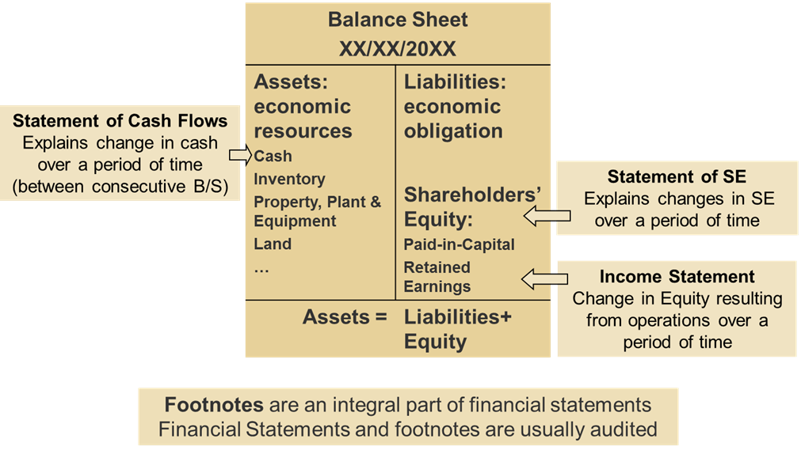
Connections among the four financial statements

Slide 15
Accounting Assumptions
Major assumptions behind accounting standards:
The firm is a going concern
Consistency in the accounting policies used over time
Conservatism: tendency to understatement of net assets (assets minus liabilities) and net income
Materiality: information must be disclosed if it is material (if it has the ability to affect outsiders’ assessment of the firm’s value)
Financial accounting standards often reflect a trade-off between:
Reliability (how objective is the information provided to outsiders) and
Relevance (how valuable is the information provided to outsiders)

